Slide 1
Digital Design & Computer Arch. Lecture 18b: Systolic Arrays and Beyond
Prof. Onur Mutlu
ETH Zürich
Spring 2020
30 April 2020

Slide 2
Bachelor’s Seminar in Comp Arch
Fall 2020
2 credit units
Rigorous seminar on fundamental and cutting-edge topics in computer architecture
Critical presentation, review, and discussion of seminal works in computer architecture
We will cover many ideas & issues, analyze their tradeoffs, perform critical thinking and brainstorming
Participation, presentation, synthesis report
You can register for the course online
https://safari.ethz.ch/architecture_seminar/spring2020/doku.php

Slide 3
Announcement
If you are interested in learning more and doing research in Computer Architecture, three suggestions:
Email me with your interest (CC: Juan)
Take the seminar course and the “Computer Architecture” course
Do readings and assignments on your own
There are many exciting projects and research positions available, spanning:
Memory systems
Hardware security
GPUs, FPGAs, heterogeneous systems, …
New execution paradigms (e.g., in-memory computing)
Security-architecture-reliability-energy-performance interactions
Architectures for medical/health/genomics

Slide 4
Broader Agenda
Single-cycle Microarchitectures
Multi-cycle and Microprogrammed Microarchitectures
Pipelining
Issues in Pipelining: Control & Data Dependence Handling, State Maintenance and Recovery, …
Out-of-Order Execution
Other Execution Paradigms

Slide 5
Approaches to (Instruction-Level) Concurrency
Pipelining
Out-of-order execution
Dataflow (at the ISA level)
Superscalar Execution
VLIW
Systolic Arrays
Decoupled Access Execute
Fine-Grained Multithreading
SIMD Processing (Vector and array processors, GPUs)

Slide 6
Readings for Today
Required
H. T. Kung, “Why Systolic Architectures?,” IEEE Computer 1982.
Recommended
Jouppi et al., “In-Datacenter Performance Analysis of a Tensor Processing Unit”, ISCA 2017.

Slide 7
Readings for Next Week
Required
Lindholm et al., "NVIDIA Tesla: A Unified Graphics and Computing Architecture," IEEE Micro 2008.
Recommended
Peleg and Weiser, “MMX Technology Extension to the Intel Architecture,” IEEE Micro 1996.

Slide 8
Systolic Arrays

Slide 9
Systolic Arrays: Motivation
Goal: design an accelerator that has
Simple, regular design (keep # unique parts small and regular)
High concurrency → high performance
Balanced computation and I/O (memory) bandwidth
Idea: Replace a single processing element (PE) with a regular array of PEs and carefully orchestrate flow of data between the PEs
such that they collectively transform a piece of input data before outputting it to memory
Benefit: Maximizes computation done on a single piece of data element brought from memory

Slide 10
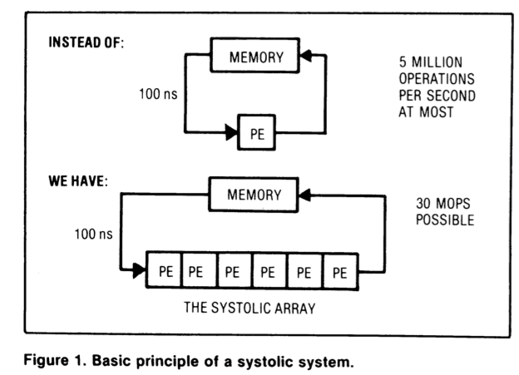
Systolic Arrays
Memory: heart
Data: blood
PEs: cells
Memory pulses
data through
PEs
H. T. Kung, “Why Systolic Architectures?,” IEEE Computer 1982.

Slide 11
Why Systolic Architectures?
Idea: Data flows from the computer memory in a rhythmic fashion, passing through many processing elements before it returns to memory
Similar to blood flow: heart → many cells → heart
Different cells “process” the blood
Many veins operate simultaneously
Can be many-dimensional
Why? Special purpose accelerators/architectures need
Simple, regular design (keep # unique parts small and regular)
High concurrency → high performance
Balanced computation and I/O (memory) bandwidth

Slide 12
Systolic Architectures
Basic principle: Replace a single PE with a regular array of PEs and carefully orchestrate flow of data between the PEs
Balance computation and memory bandwidth
Differences from pipelining:
These are individual PEs
Array structure can be non-linear and multi-dimensional
PE connections can be multidirectional (and different speed)
PEs can have local memory and execute kernels (rather than a piece of the instruction)

Slide 13
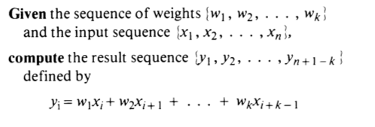
Systolic Computation Example
Convolution
Used in filtering, pattern matching, correlation, polynomial evaluation, etc …
Many image processing tasks
Machine learning: up to hundreds of convolutional layers in Convolutional Neural Networks (CNN)

Slide 14
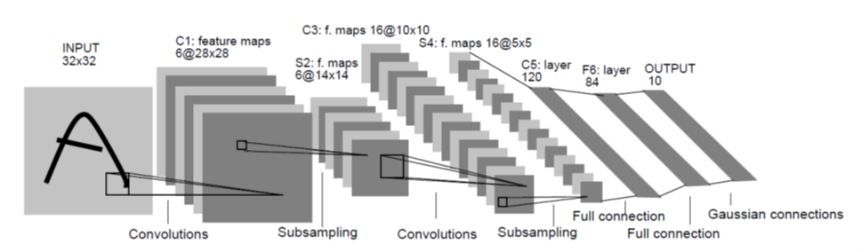
LeNet-5, a Convolutional Neural Network for Hand-Written Digit Recognition
This is a 1024*8 bit input, which will have a truth table of 2 ⁸¹⁹⁶ entries
Slide credit: Hwu & Kirk

Slide 15
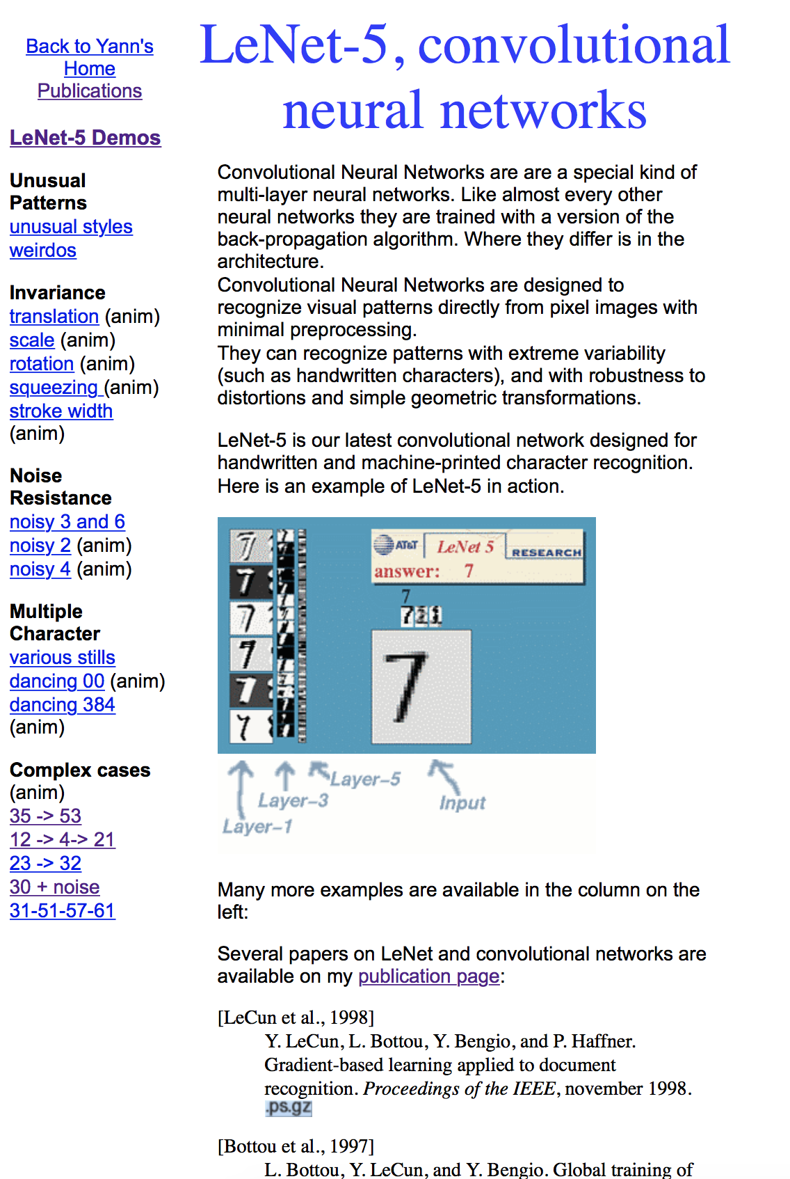

Convolutional Neural Networks: Demo
http://yann.lecun.com/exdb/lenet/index.html

Slide 16
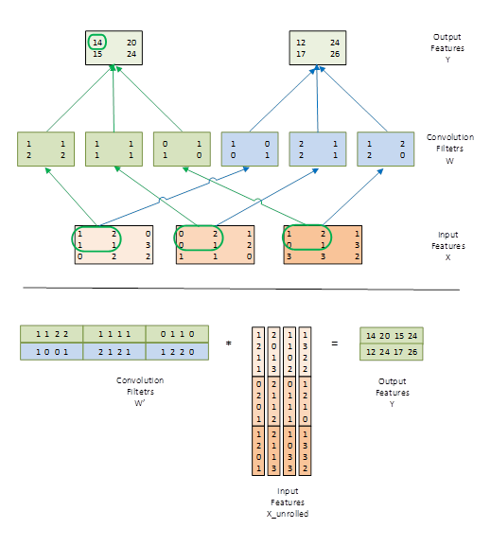
Implementing a Convolutional Layer with Matrix Multiplication
12
Slide credit: Hwu & Kirk

Slide 17
Power of Convolutions and Applied Courses
In 2010, Prof. Andreas Moshovos adopted Professor Hwu’s ECE498AL Programming Massively Parallel Processors Class
Several of Prof. Geoffrey Hinton’s graduate students took the course
These students developed the GPU implementation of the Deep CNN that was trained with 1.2M images to win the ImageNet competition
Slide credit: Hwu & Kirk

Slide 18
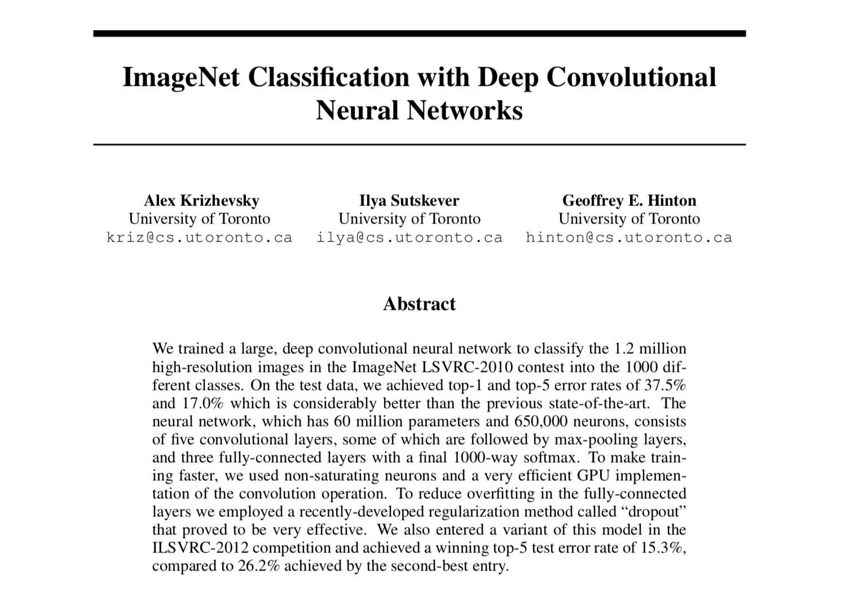
Example: AlexNet (2012)
AlexNet won ImageNet with more than 10.8% points ahead of the runner up
Krizhevsky et al., “ImageNet Classification with Deep Convolutional Neural Networks”, NIPS 2012.

Slide 19
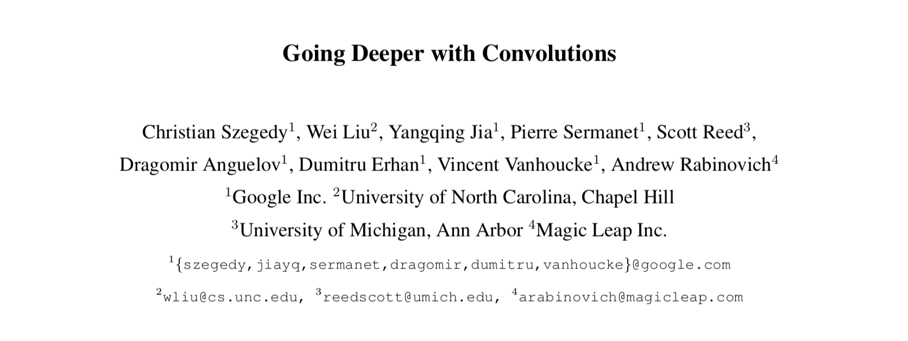
Example: GoogLeNet (2014)
Google improves accuracy by adding more layers
From 8 in AlexNet to 22 in GoogLeNet
Szegedy et al., “Going Deeper with Convolutions”, CVPR 2015.

Slide 20
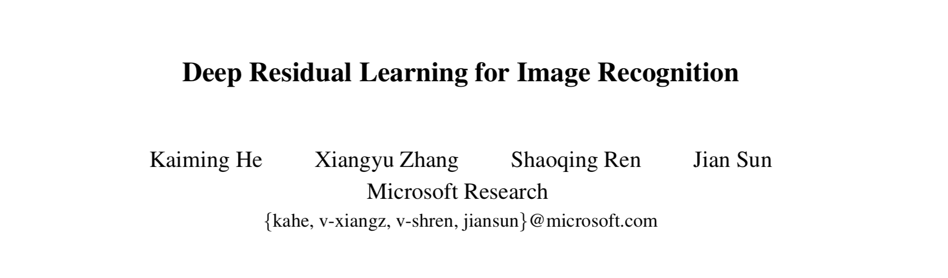
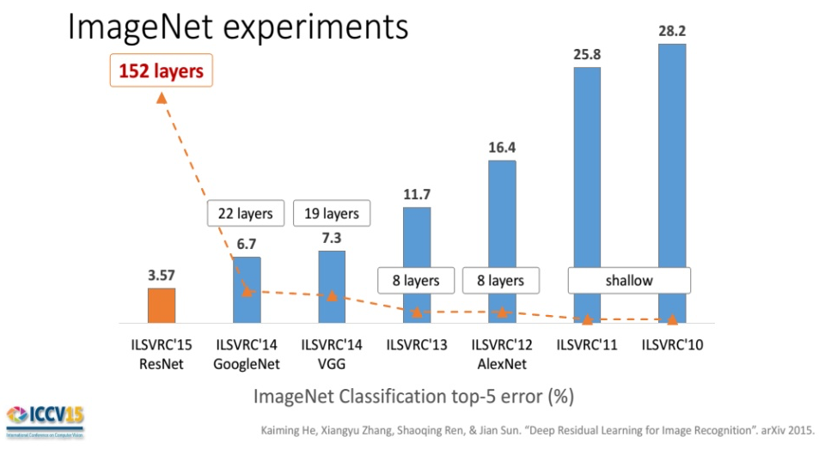
Example: ResNet (2015)
He et al., “Deep Residual Learning for Image Recognition”, CVPR 2016.
First CNN
Human: 5.1%

Slide 21
Systolic Computation Example: Convolution (I)
Convolution
Used in filtering, pattern matching, correlation, polynomial evaluation, etc …
Many image processing tasks
Machine learning: up to hundreds of convolutional layers in Convolutional Neural Networks (CNN)

Slide 22
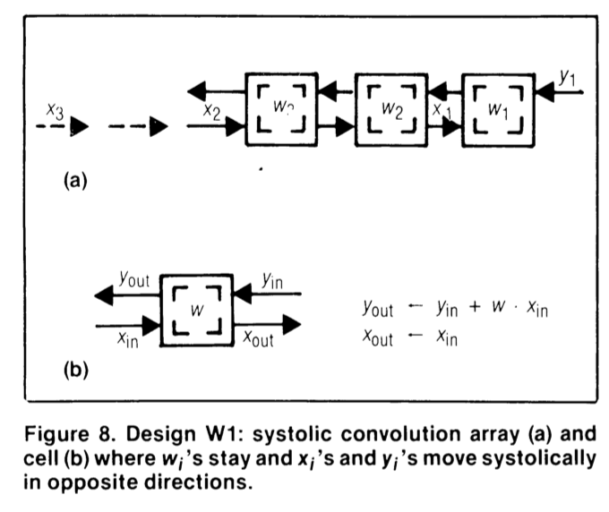
Systolic Computation Example: Convolution (II)
y1 = w1x1 + w2x2 + w3x3
y2 = w1x2 + w2x3 + w3x4
y3 = w1x3 + w2x4 + w3x5

Slide 23
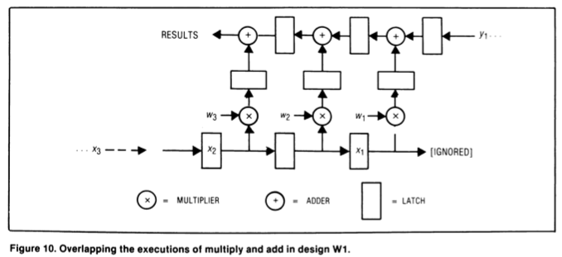
Systolic Computation Example: Convolution (III)
Worthwhile to implement adder and multiplier separately to allow overlapping of add/mul executions

Slide 24
Systolic Computation Example: Convolution (IV)
One needs to carefully orchestrate when data elements are input to the array
And when output is buffered
This gets more involved when
Array dimensionality increases
PEs are less predictable in terms of latency

Slide 25
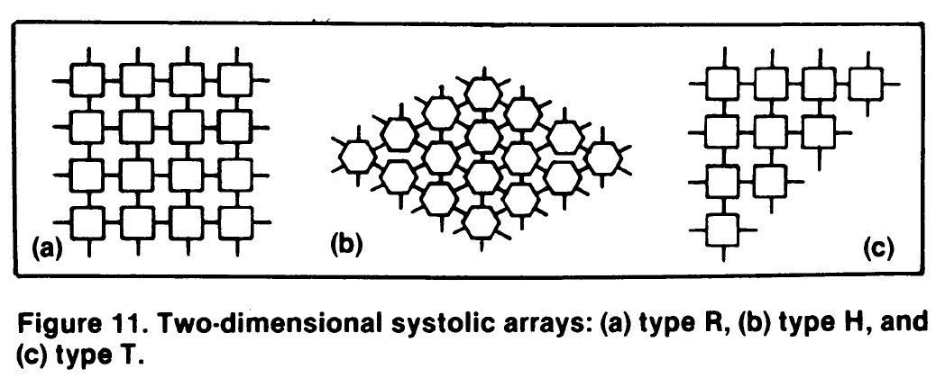
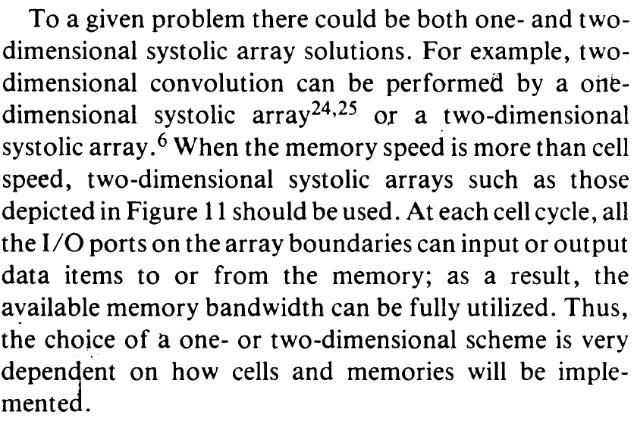
Two-Dimensional Systolic Arrays

Slide 26
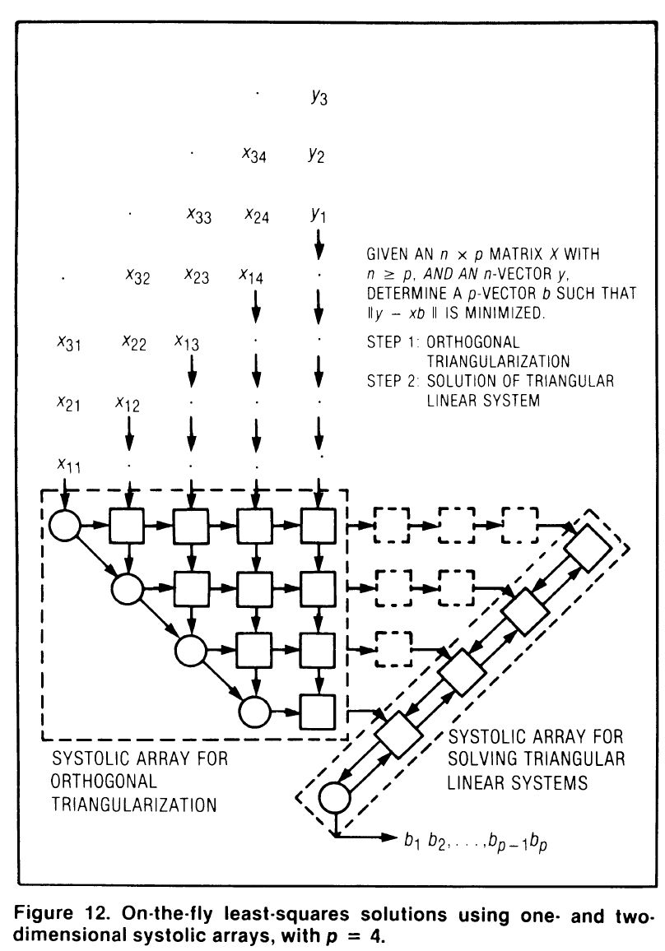
Combinations
Systolic arrays can be chained together to form powerful systems
This systolic array is capable of producing on-the-fly least-squares fit to all the data that has arrived up to any given moment

Slide 27
Systolic Arrays: Pros and Cons
Advantages:
Principled: Efficiently makes use of limited memory bandwidth, balances computation to I/O bandwidth availability
Specialized (computation needs to fit PE organization/functions)
→ improved efficiency, simple design, high concurrency/ performance
→ good to do more with less memory bandwidth requirement
Downside:
Specialized
→ not generally applicable because computation needs to fit the PE functions/organization

Slide 28
More Programmability in Systolic Arrays
Each PE in a systolic array
Can store multiple “weights”
Weights can be selected on the fly
Eases implementation of, e.g., adaptive filtering
Taken further
Each PE can have its own data and instruction memory
Data memory → to store partial/temporary results, constants
Leads to stream processing, pipeline parallelism
More generally, staged execution

Slide 29
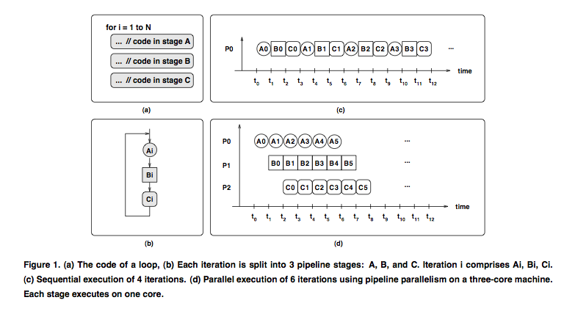
Pipeline-Parallel (Pipelined) Programs

Slide 30
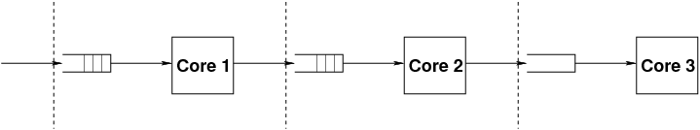
Stages of Pipelined Programs
Loop iterations are divided into code segments called stages
Threads execute stages on different cores
A
B
C
loop {
Compute1
Compute2
Compute3
}
A
B
C

Slide 31
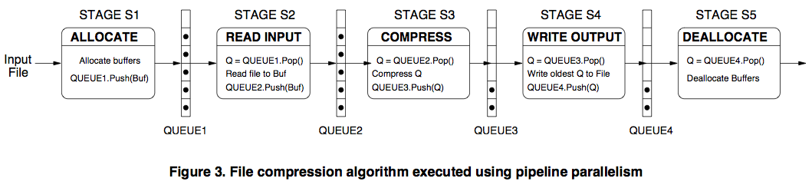
Pipelined File Compression Example

Slide 32
Systolic Array: Advantages & Disadvantages
Advantages
Makes multiple uses of each data item → reduced need for fetching/refetching → better use of memory bandwidth
High concurrency
Regular design (both data and control flow)
Disadvantages
Not good at exploiting irregular parallelism
Relatively special purpose → need software, programmer support to be a general purpose model

Slide 33
Example Systolic Array: The WARP Computer
HT Kung, CMU, 1984-1988
Linear array of 10 cells, each cell a 10 Mflop programmable processor
Attached to a general purpose host machine
HLL and optimizing compiler to program the systolic array
Used extensively to accelerate vision and robotics tasks
Annaratone et al., “Warp Architecture and Implementation,” ISCA 1986.
Annaratone et al., “The Warp Computer: Architecture, Implementation, and Performance,” IEEE TC 1987.

Slide 34
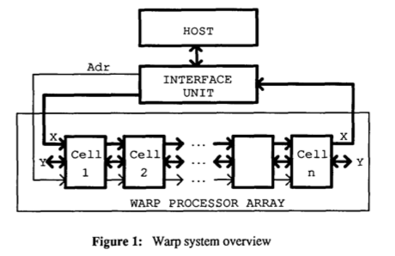
The WARP Computer

Slide 35
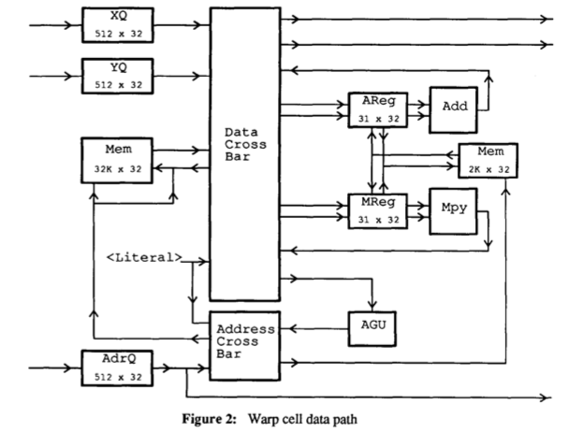
The WARP Cell

Slide 36
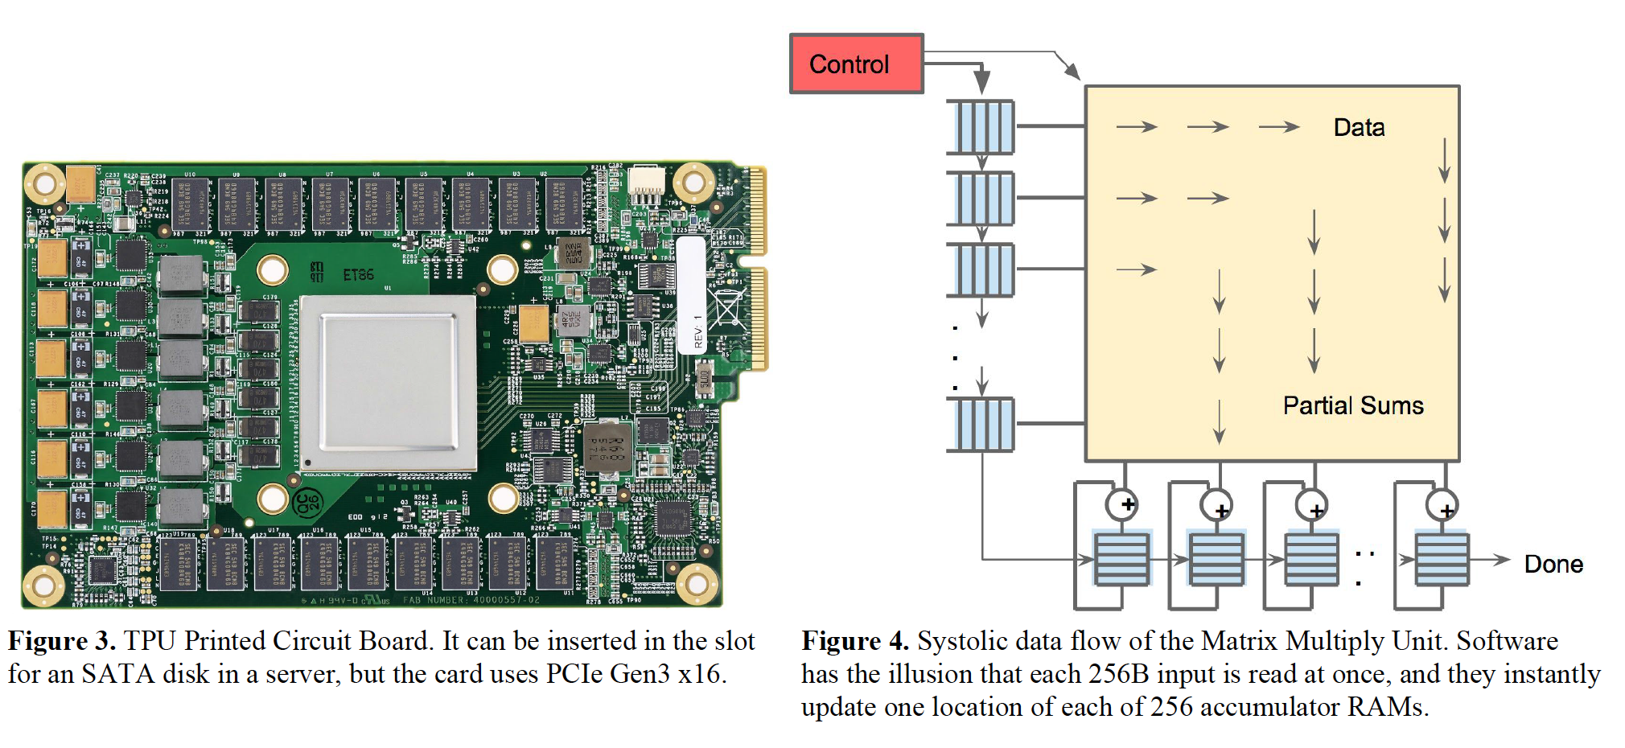
An Example Modern Systolic Array: TPU (I)
Jouppi et al., “In-Datacenter Performance Analysis of a Tensor Processing Unit”, ISCA 2017.

Slide 37
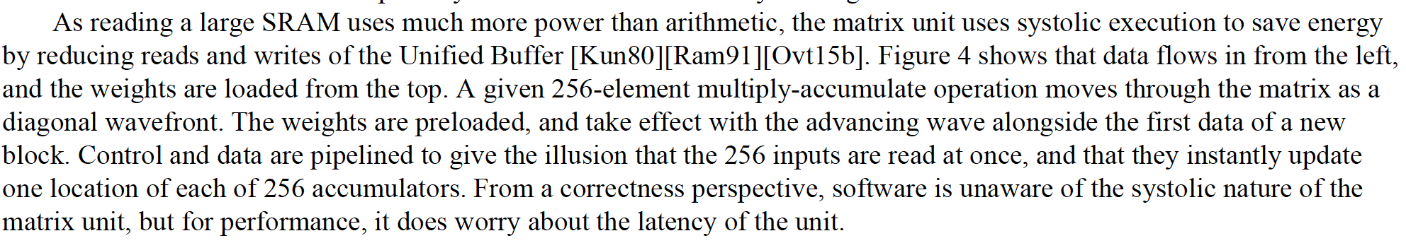
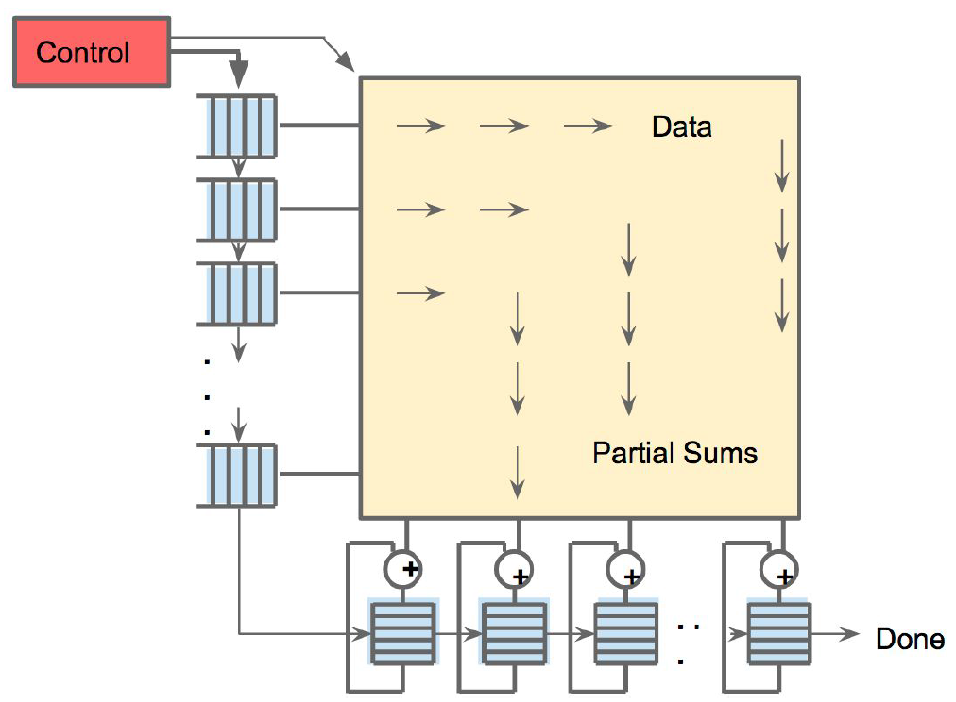
An Example Modern Systolic Array: TPU (II)
Jouppi et al., “In-Datacenter Performance Analysis of a Tensor Processing Unit”, ISCA 2017.

Slide 38
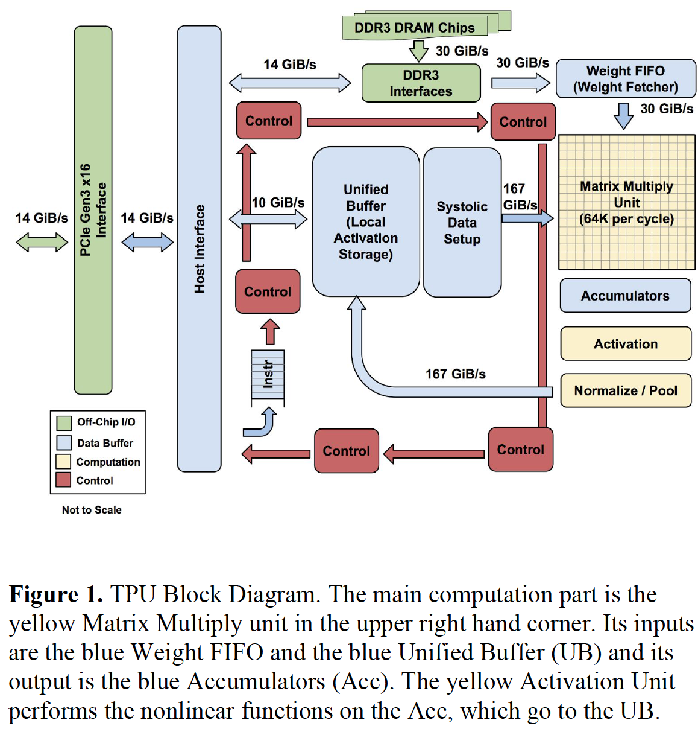
An Example Modern Systolic Array: TPU (III)

Slide 39
TPU: Second Generation
4 TPU chips
vs 1 chip in TPU1
High Bandwidth Memory
vs DDR3
Floating point operations
vs FP16
45 TFLOPS per chip
vs 23 TOPS
https://www.nextplatform.com/2017/05/17/first-depth-look-googles-new-second-generation-tpu/
Designed for training
and inference
vs only inference

Slide 40
Approaches to (Instruction-Level) Concurrency
Pipelining
Out-of-order execution
Dataflow (at the ISA level)
Superscalar Execution
VLIW
Systolic Arrays
Decoupled Access Execute
Fine-Grained Multithreading
SIMD Processing (Vector and array processors, GPUs)

Slide 41
Decoupled Access/Execute (DAE)

Slide 42
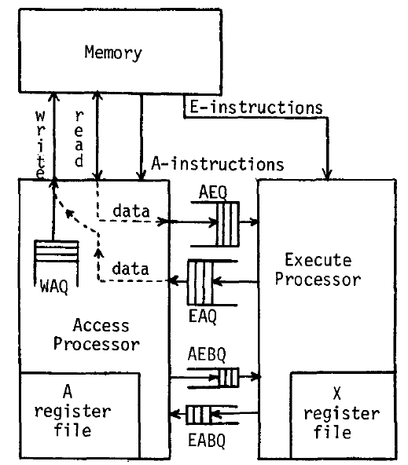
Decoupled Access/Execute (DAE)
Motivation: Tomasulo’s algorithm too complex to implement
1980s before Pentium Pro
Idea: Decouple operand
access and execution via
two separate instruction
streams that communicate
via ISA-visible queues.
Smith, “Decoupled Access/Execute
Computer Architectures,” ISCA 1982,
ACM TOCS 1984.

Slide 43
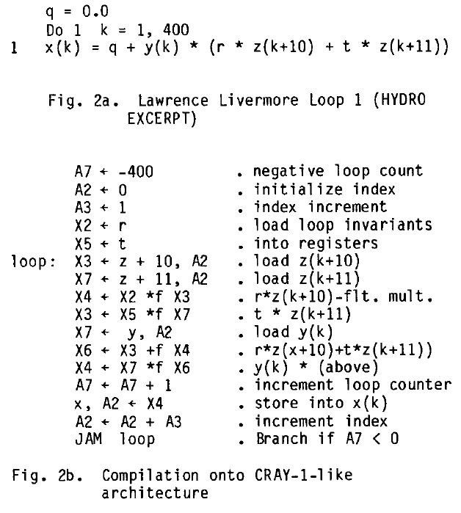
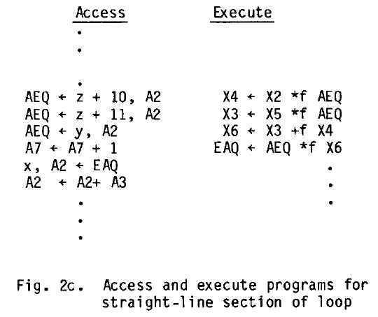
Decoupled Access/Execute (II)
Compiler generates two instruction streams (A and E)
Synchronizes the two upon control flow instructions (using branch queues)

Slide 44
Decoupled Access/Execute (III)
Advantages:
+ Execute stream can run ahead of the access stream and vice versa
+ If A is waiting for memory, E can perform useful work
+ If A hits in cache, it supplies data to lagging E
+ Queues reduce the number of required registers
+ Limited out-of-order execution without wakeup/select complexity
Disadvantages:
-- Compiler support to partition the program and manage queues
-- Determines the amount of decoupling
-- Branch instructions require synchronization between A and E
-- Multiple instruction streams (can be done with a single one, though)

Slide 45
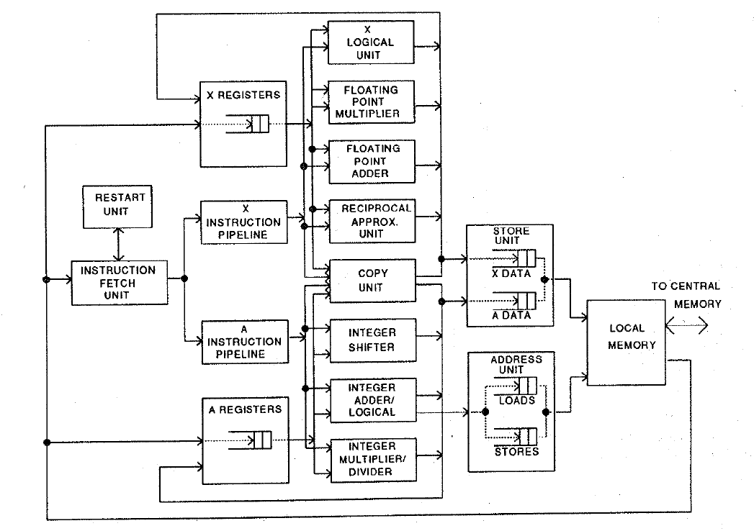
Astronautics ZS-1
Single stream steered into A and X pipelines
Each pipeline in-order
Smith et al., “The ZS-1 central processor,” ASPLOS 1987.
Smith, “Dynamic Instruction Scheduling and the Astronautics ZS-1,” IEEE Computer 1989.

Slide 46
Loop Unrolling to Eliminate Branches
Idea: Replicate loop body multiple times within an iteration
+ Reduces loop maintenance overhead
Induction variable increment or loop condition test
+ Enlarges basic block (and analysis scope)
Enables code optimization and scheduling opportunities
-- What if iteration count not a multiple of unroll factor? (need extra code to detect this)
-- Increases code size
for (int i = 0; i < N; i++){
A[i] = A[i] + B[i];
}
for (int i = 0; i < N; i+=4){
A[i] = A[i] + B[i];
A[i+1] = A[i+1] + B[i+1];
A[i+2] = A[i+2] + B[i+2];
A[i+3] = A[i+3] + B[i+3];
}
for (int i = 0; i < N; ){
}
for (int i = 0; i < N; ){
A[i] = A[i] + B[i];
A[i+1] = A[i+1] + B[i+1];
A[i+2] = A[i+2] + B[i+2];
A[i+3] = A[i+3] + B[i+3];
}
for (int i = 0; i < N; i+=4){
A[i] = A[i] + B[i];
A[i+1] = A[i+1] + B[i+1];
A[i+2] = A[i+2] + B[i+2];
A[i+3] = A[i+3] + B[i+3];
}

Slide 47
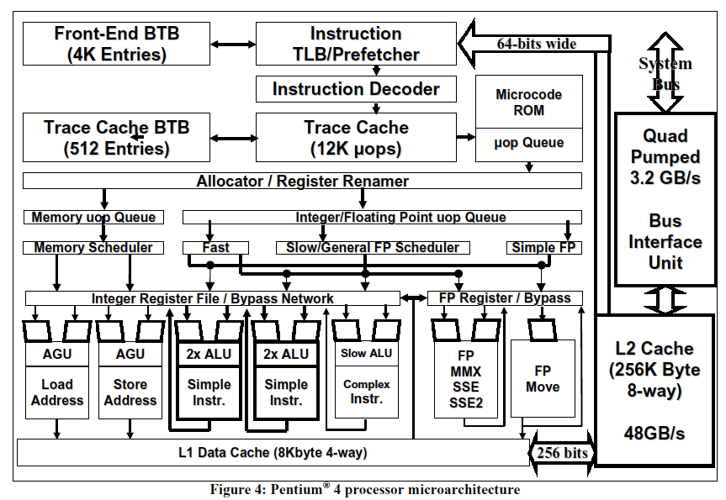
A Modern DAE Example: Pentium 4
Boggs et al., “The Microarchitecture of the Pentium 4 Processor,” Intel Technology Journal, 2001.

Slide 48
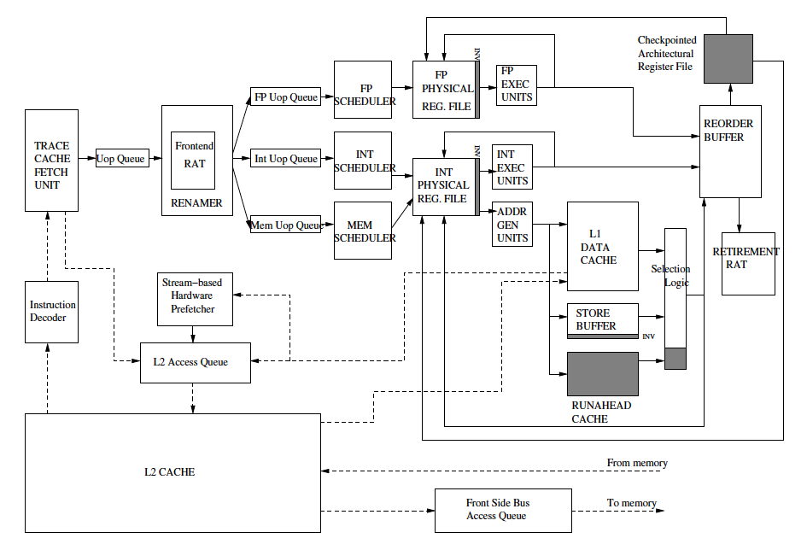
Intel Pentium 4 Simplified
Mutlu+, “Runahead Execution,”
HPCA 2003.

Slide 49
Approaches to (Instruction-Level) Concurrency
Pipelining
Out-of-order execution
Dataflow (at the ISA level)
Superscalar Execution
VLIW
Systolic Arrays
Decoupled Access Execute
Fine-Grained Multithreading
SIMD Processing (Vector and array processors, GPUs)

Slide 50
Digital Design & Computer Arch. Lecture 18b: Systolic Arrays and Beyond
Prof. Onur Mutlu
ETH Zürich
Spring 2020
30 April 2020

